Slide 1
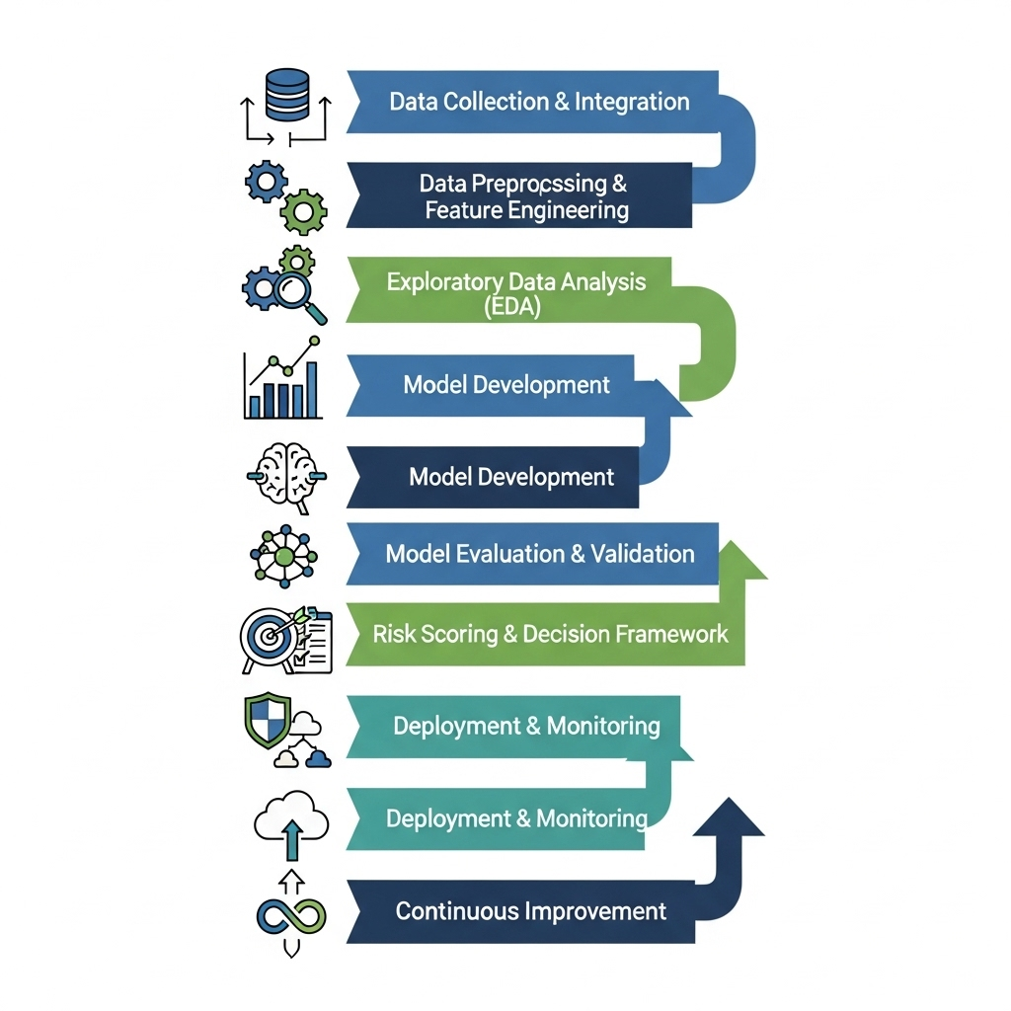
CREDIT RISK ANALYSIS

